Slide 1



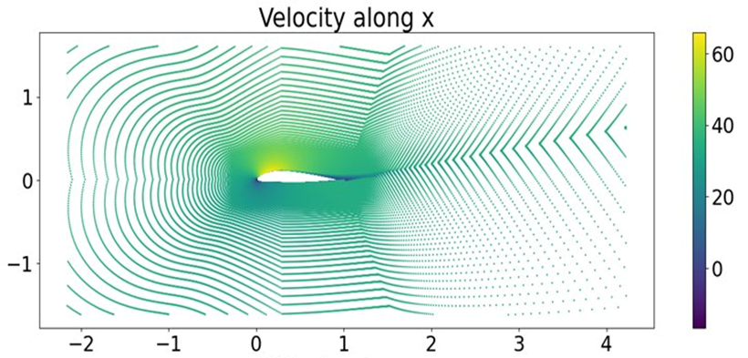

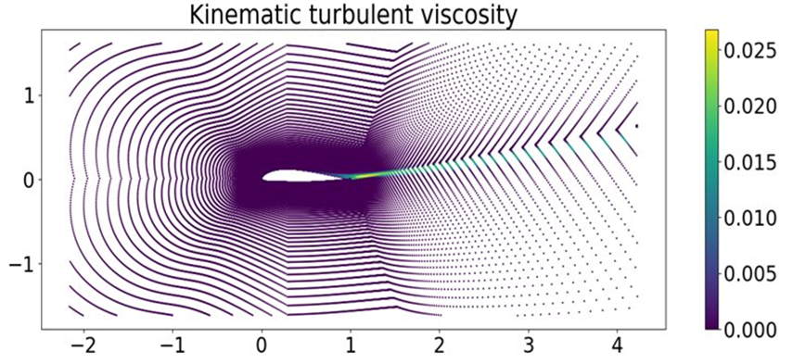
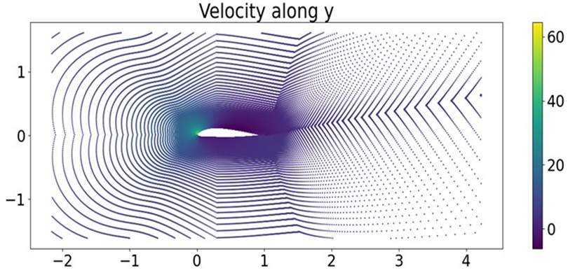
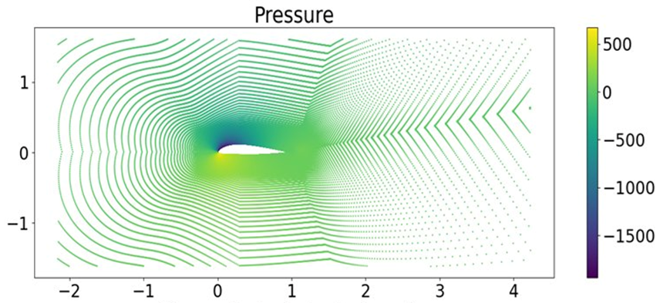
Surrogate Modeling of CFD Flow Fields using Graph Attention Networks on the AirfRANS Dataset Jihoon Heo¹, Kyungyun Kim^{1,2}, Minjun Lee¹, Yunwoo Lee¹ ¹Department of Mechanical Engineering, University of Yonsei, Seoul, Korea
²Department of Biomedical Engineering, University of Yonsei, Wonju, Korea
Introduction
Computational Fluid Dynamics (CFD) is widely used to analyze aerodynamic flow fields, but high-fidelity RANS simulations require significant computational cost. To reduce computation time, machine learning surrogate models have been proposed to approximate CFD results efficiently. In this study, we build upon the ML4CFD competition framework using the AirfRANS dataset. We apply a Graph Attention Network (GAT) to predict flow field variables from mesh-based graph data. The objective of this work is to evaluate the effectiveness of graph neural networks for surrogate modeling of CFD simulations.
AirfRANS Dataset
Reynolds- Averged Navier-Stokes equations
AirfRANS is a public benchmark dataset
providing CFD simulation results of 2D
RANS steady-state, incompressible airflow around airfoil geometries.
Mesh nodes from OpenFOAM: simulations serve as the point cloud input to the model.
Inputs (per mesh node)
The Reynolds-averaged Navier–Stokes (RANS) approach decomposes the
instantaneous velocity into a mean and fluctuating component: $U_{i}={\overline{U}}_{i}+u_{i}$
Averaging the Navier–Stokes equations yields the Reynolds equations:
$$\frac{\overline{DU_{j}}}{\overline{D}t}=ν∇^{2}{\overline{U}}_{j}−\frac{∂\overline{u_{i}u_{j}}}{∂x_{i}}−\frac{1}{ρ}\frac{∂\overset{‾}{p}}{∂x_{j}}$$
The Reynolds stress tensor ​​ $\overset{‾}{−u_{i}}\overset{‾}{u_{j}}$ introduces the closure problem: it cannot be derived from mean quantities alone. Under the Boussinesq turbulent-viscosity hypothesis:
$$−\overline{u_{i}u_{j}}+\frac{2}{3}kδ_{ij}=ν_{T} \left(\frac{∂{\overline{U}}_{i}}{∂x_{j}}+\frac{∂{\overline{U}}_{j}}{∂x_{i}}\right)$$
The turbulent viscosity $ν_{T}$ is computed via the k–ω SST model, making it one of the four flow fields our surrogate model must predict.
Position (x, y)
Inlet velocity (u, v)
Surface normal (nₓ, nᵧ)
Distance to surface d
Dataset Splits
Outputs (target flow fields)
Train: 200 simulations
Velocity (u, v)
Test: 200 simulations (in-distribution)
Pressure/density (p/ρ)
OOD Test: 496 simulations (unseen Re)
Turbulent viscosity (νₜ)
Fig. 1 Sample Simulation output (a) Velocity — x component [m/s] (b) Pressure [Pa/ρ] (c) Velocity — y component [m/s] (d) Kinematic turbulent viscosity [m²/s]
(a)
(b)
Method
(c)
(d)
Training Strategy
Results - Model Performance &Visualization
Conclusion

Slide 2
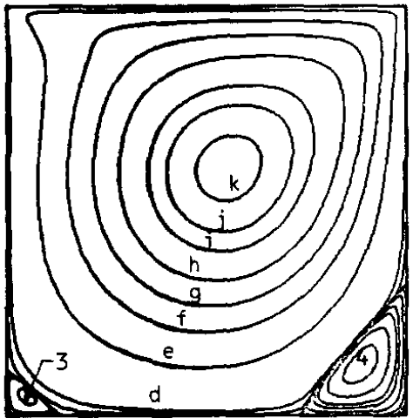
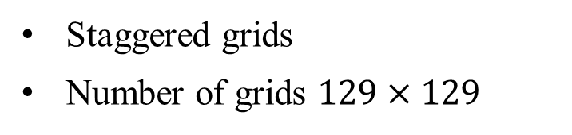
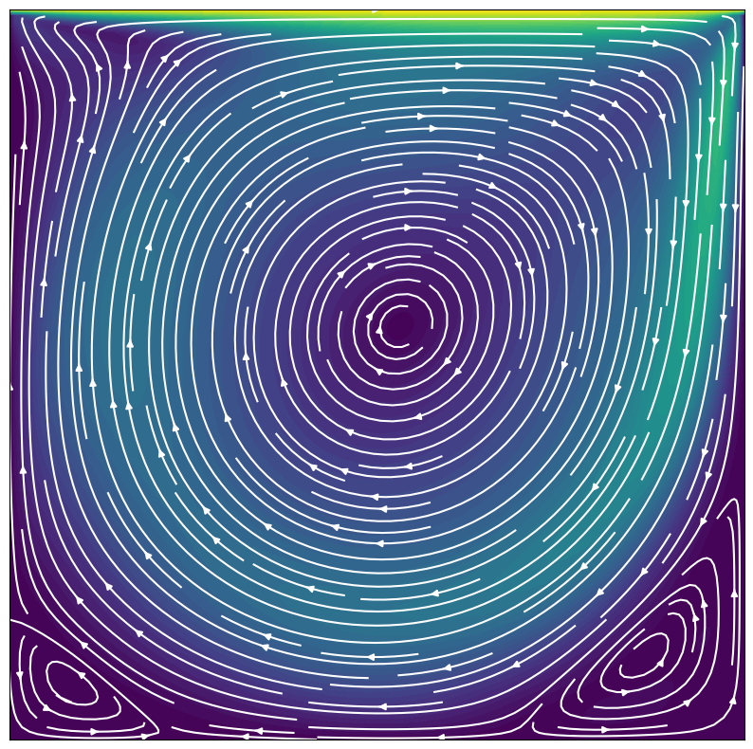
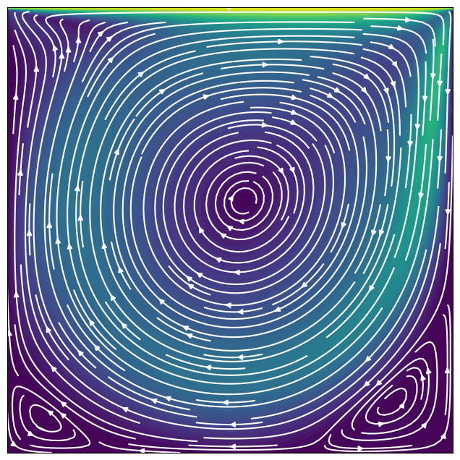

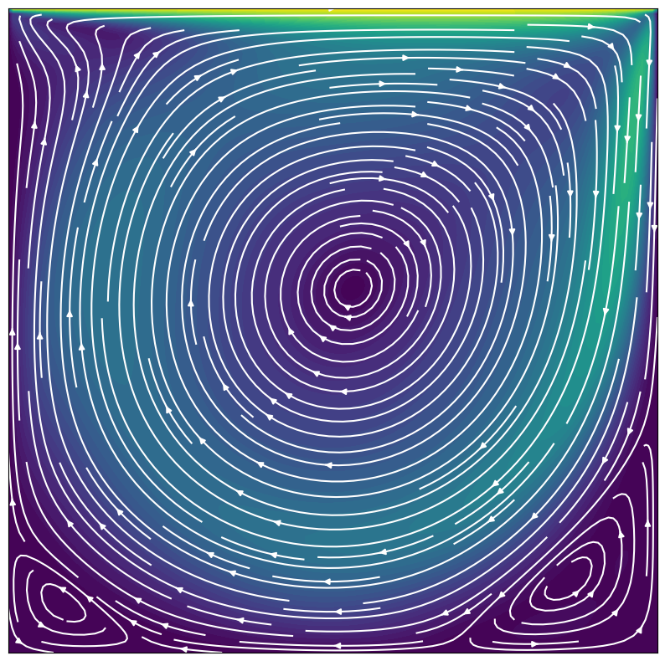
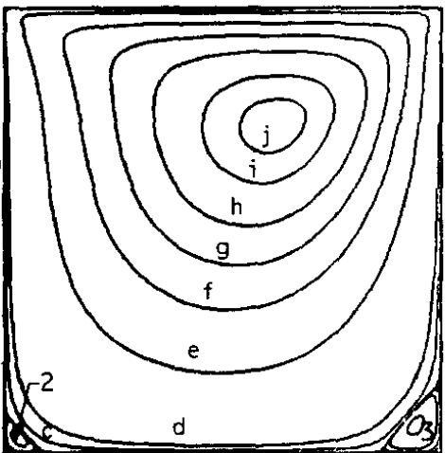

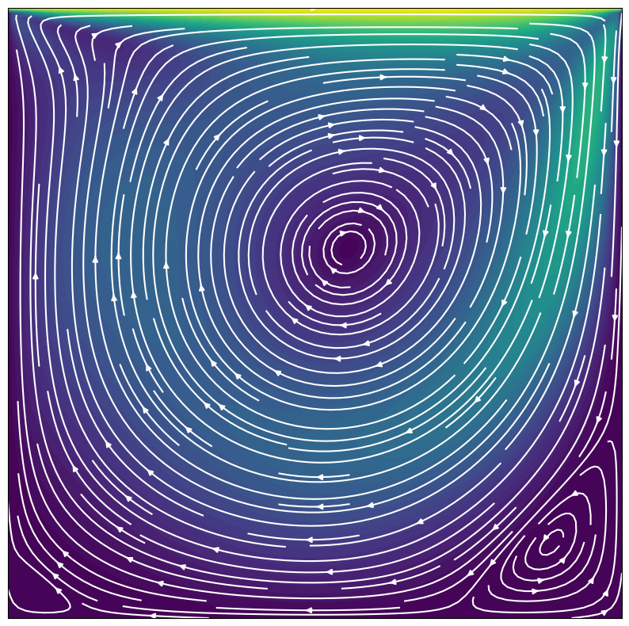
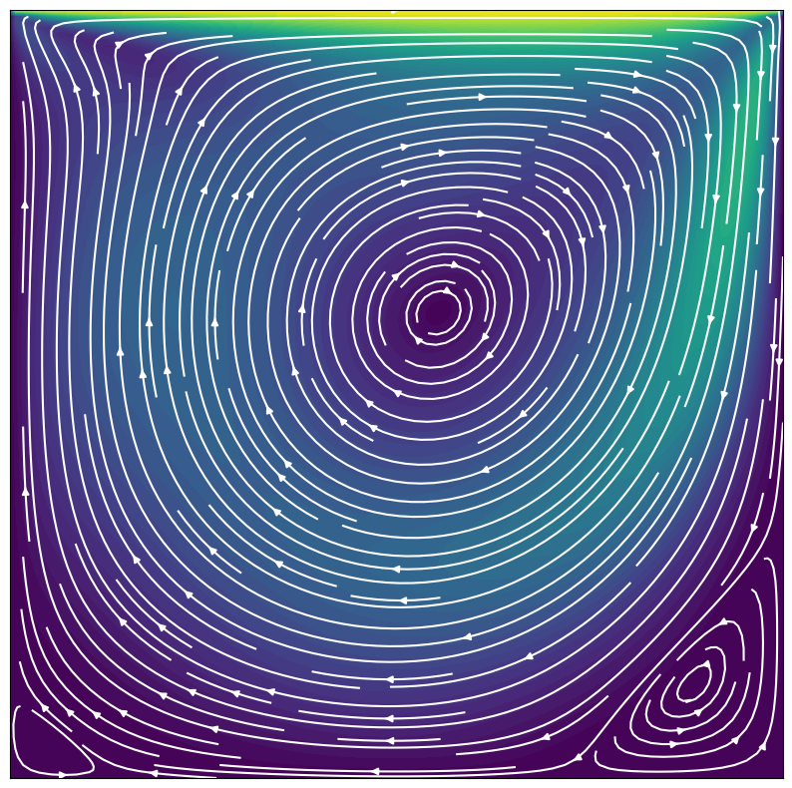
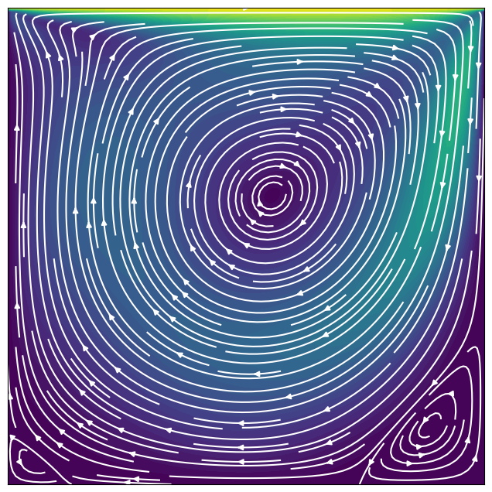
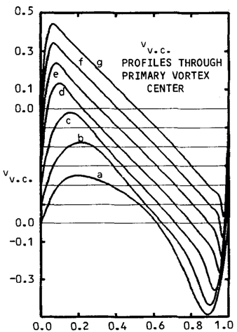

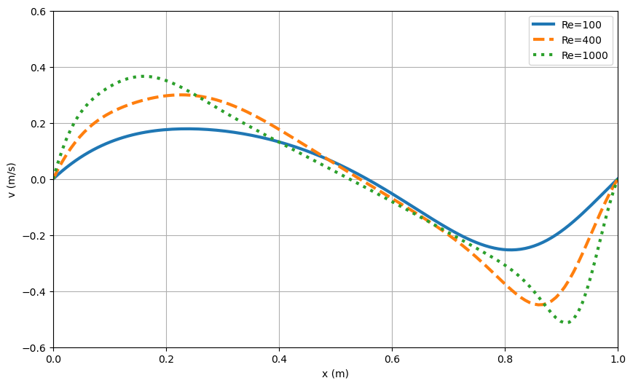
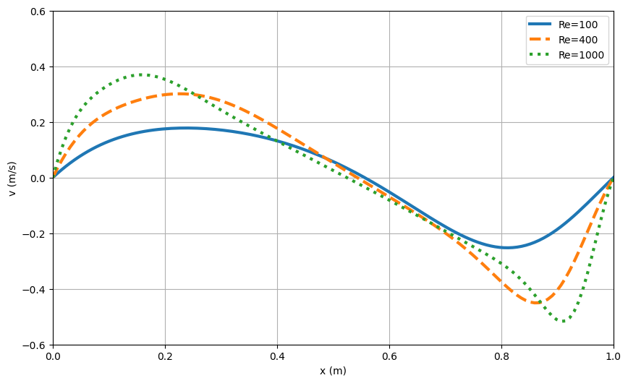

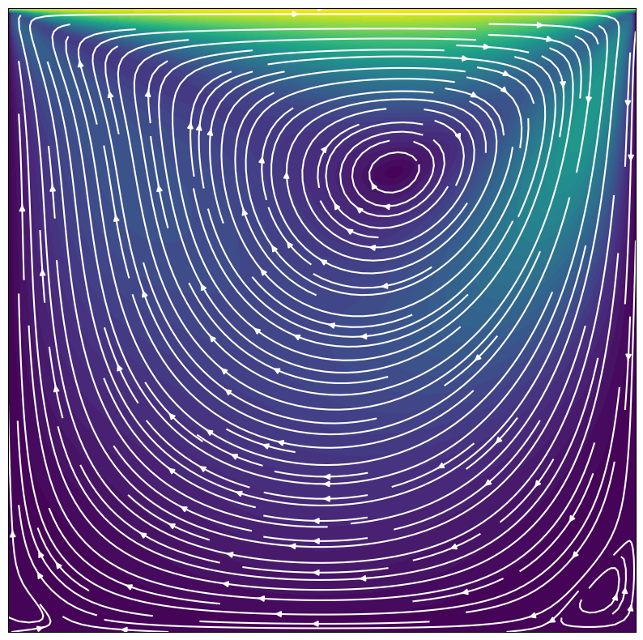
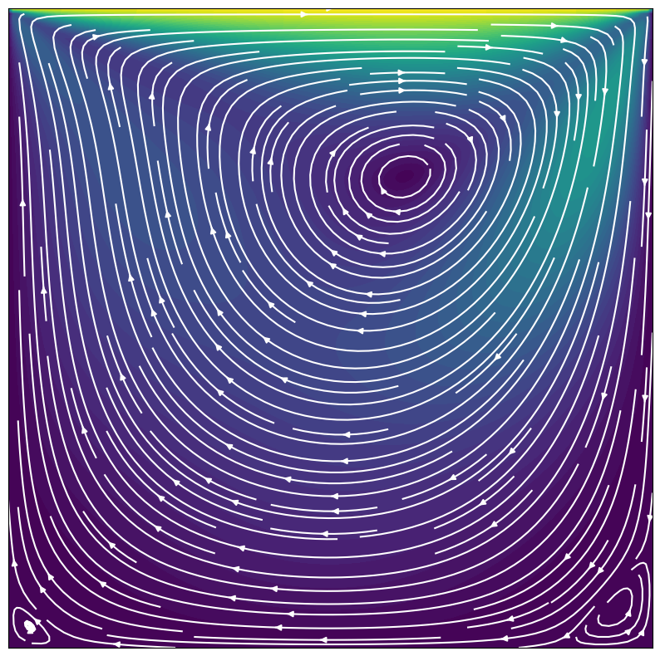
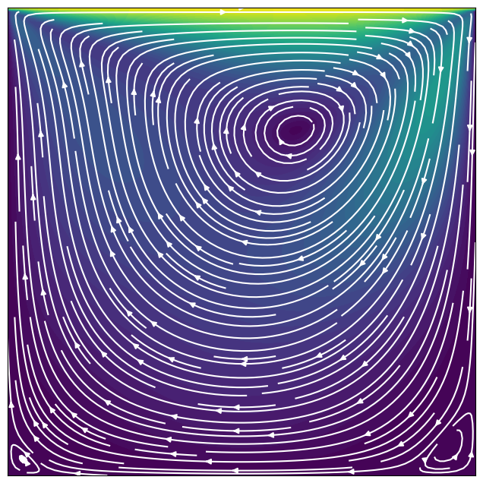
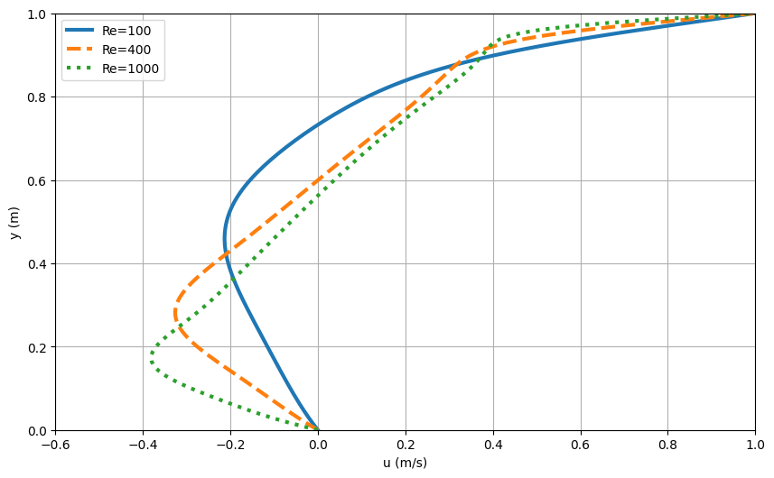

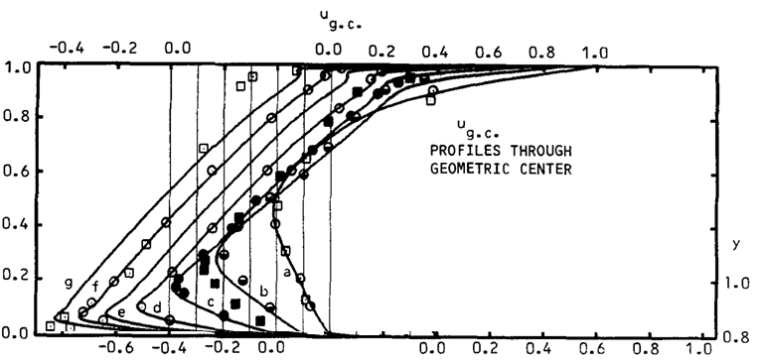





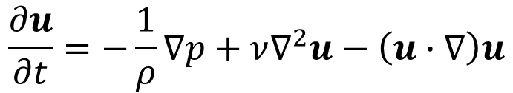

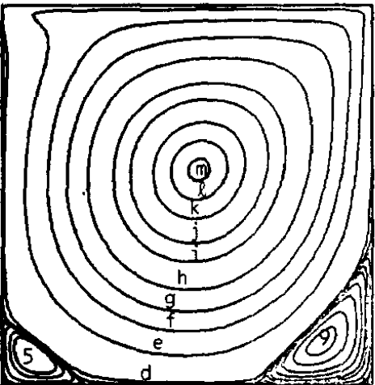

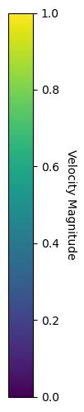


Comparative Study of 2D Lid-Driven Cavity Flow Across Python, Ansys Fluent, and OpenFOAM Seong Won Jeong¹, Hye Rin Lim², Ki Sung Park³ ¹Department of Atmospheric Sciences, University of Yonsei, Seoul, Korea ²Department of Mechanical Engineering, University of Yonsei, Seoul, Korea
³Department of Mechanical Systems Engineering, University of Myongji, Yongin, Korea
Introduction
The two-dimensional lid-driven cavity problem has long been considered a benchmark case in computational fluid dynamics, extensively studied and validated both experimentally and numerically. With the advancement of computational power, obtaining numerical solutions to this problem has become relatively accessible even with only fundamental knowledge of fluid dynamics. In this study, a Python code based on the projection method is developed to solve the two-dimensional lid-driven cavity, and the results are compared against the classical data of Ghia et al., commercial software (Ansys), and the open-source solver (OpenFOAM).
Lid Driven Cavity
Python
Solve 2D lid driven cavity flow with Numerical Analysis
<Numerical Modeling>
<Spatial Grids>
<Governing Equation>
$$u_{lid}\left(t≥0\right)=U, v=0$$
$$u\left(x, t<0\right)=0$$
$$v\left(x, t<0\right)=0$$
Convection term
2nd Adams-Bashforth method
Diffusion term
Crank-Nicolson method
Projection method
$∆t=0.01\left(Re=100, 400\right), 0.005 (Re=1000)$
Staggered grids
Number of grids $129×129$
Navier-Stokes equations
$$\frac{∂u}{∂t}=−\frac{1}{ρ}∇p+ν∇^{2}u−\left(u∙∇\right)u$$
H = 1
$$u=v=0$$
$$v_{i,j}$$
Continuity equation
H = 1
Reynolds Number
$$u_{i−1,j}$$
$$P_{i,j}$$
$$u_{i,j}$$
$$∇∙u=0$$
$$Re= \frac{u_{lid}H}{ν}$$
$$v_{i,j−1}$$
Ghia et al (1982)
Fig. 3 Streamline pattern of (a) Re 100, (b) Re 400 and (c) Re 1000 at the steady state with python
Fig. 4 Comparison of (a) u-velocity along vertical lines and (b) v-velocity along horizontal lines with python
Fig. 1 Streamline pattern of (a) Re 100, (b) Re 400 and (c) Re 1000 at the steady state
Fig. 2 Comparison of (a) u-velocity along vertical lines and (b) v-velocity along horizontal lines
(a)
(b)
(c)
(a)
(b)
(c)
(a)
(b)
(a)
(b)
Ansys Fluent
OpenFOAM (Open-source Field Operation And Manipulation)
Convection term
Second order Upwind
Diffusion term
Central differencing (second order, default)
Transient Formulation
Second order Implicit
OpenFOAM is a free open-source CFD software which written in C++. It primarily solves problems in three dimensions.
However, by specifying the z-direction thickness as one cell layer and setting the boundary conditions 'empty' for the front and back faces, it can perform 2D simulations.
<Numerical Modeling>
ANSYS is a commercial software package capable of simulating a wide range of engineering problems.
In this study, ANSYS Fluent 2025 R1 was used, and the computations were performed using the Finite Volume Method (FVM).
<Numerical Modeling>
Explicit operation
Finite Volume Calculus
Implicit operation
Finite Volume Method
Pressure-Based Solver
SIMPLE(Semi-Implicit Method for Pressure-Linked Equations) scheme
PISO (Pressure-Implicit with Splitting of Operators) algorithm
Fig. 5 Streamline pattern of (a) Re 100, (b) Re 400 and (c) Re 1000 at the steady state with Ansys
Fig. 6 Comparison of (a) u-velocity along vertical lines and (b) v-velocity along horizontal lines with Ansys
Fig. 3 Streamline pattern of (a) Re 100, (b) Re 400 and (c) Re 1000 at the steady state with OpenFOAM
Fig. 4 Comparison of (a) u-velocity along vertical lines and (b) v-velocity along horizontal lines with OpenFOAM
(a)
(b)
(c)
(a)
(b)
(c)
(a)
(b)
(a)
(b)
Conclusion
This study applied a Python projection method, Ansys, and OpenFOAM to the two-dimensional lid-driven cavity problem. The results closely matched the benchmark data of Ghia et al. and showed strong agreement among the methods, confirming their reliability for this classical CFD case. Furthermore, the approach can be extended to rectangular cavities with different aspect ratios and is also applicable to three-dimensional configurations.

